Slide 1
EXECUTIVE BRIEFING & TACTICAL THREAT INTELLIGENCE 2026
Enterprise Cyber Resilience,
Government Certification & Identity Defense
Comprehensive threat intelligence and turnkey compliance roadmap based on official UK NCSC, IASME, Cabinet Office PPN 09/14, CISA, and NIST SP 800 standards for commercial directors.
PREPARED BY: Lucas Malec • Mind Reflection LTD (Company No: NI626017, Belfast, Northern Ireland)
ICO DATA PROTECTION: ZA317530 • WEB: https://mindreflection.co.uk

Slide 2

ARTICLE 1 • SOCIAL ENGINEERING & WIRE FRAUD
Modern Phishing Vectors: Quishing (QR) & BEC Redirection
▶ THE QUISHING BLINDSPOT
QR codes bypass traditional Secure Email Gateways (SEGs) as embedded image pixels, tricking employees into scanning on unmonitored personal smartphones.
▶ AITM REVERSE PROXIES
Adversary-in-the-Middle tools (Evilginx) proxy authentic Microsoft 365 logins, intercepting session cookies and completely bypassing legacy SMS/push 2FA.
▶ INVOICE REDIRECTION (BEC)
Compromised supplier inboxes issue modified payment details for legitimate deliveries, costing UK firms £140M+ annually in irrecoverable wire transfers.
▶ MANDATORY DEFENSE PROTOCOL
Enforce FIDO2 hardware tokens (YubiKey) immune to origin spoofing; mandate Out-of-Band phone callbacks before modifying any supplier Sort Code.
OFFICIAL GOVERNMENT METRIC / STATISTIC:
84% of UK businesses that identified an attack reported phishing as the primary vector (UK DSIT Breaches Survey 2025/2026).
Mind Reflection LTD (Company No: NI626017, Belfast) • ICO: ZA317530 • https://mindreflection.co.uk

Slide 3

ARTICLE 2 • DATA EXTORTION & INFRASTRUCTURE SURVIVAL
Ransomware 2026: Triple Extortion & Immutable WORM Storage
▶ THE TRIPLE EXTORTION PLAYBOOK
1. Encryption of live production systems. 2. Exfiltration & threat of public leak (UK GDPR). 3. Direct DDoS / customer harassment.
▶ DWELL TIME & LATERAL MOVEMENT
Attackers sit quietly inside networks for 12–45 days, hunting domain admin credentials and systematically wiping cloud snapshots.
▶ IMMUTABLE WORM STORAGE DEFENSE
Write-Once-Read-Many storage (NIST SP 800-209) locks data blocks with cryptographic retention timers—even rogue domain admins cannot delete or encrypt backups.
▶ THE GOLDEN RULE: NEVER PAY
The UK NCSC and ICO strongly discourage ransom payments: paying finances criminal syndicates and provides zero guarantee of clean data decryption.
OFFICIAL GOVERNMENT METRIC / STATISTIC:
94% of ransomware attacks in 2025 actively targeted backup repositories to eliminate recovery options (Sophos State of Ransomware).
Mind Reflection LTD (Company No: NI626017, Belfast) • ICO: ZA317530 • https://mindreflection.co.uk

Slide 4
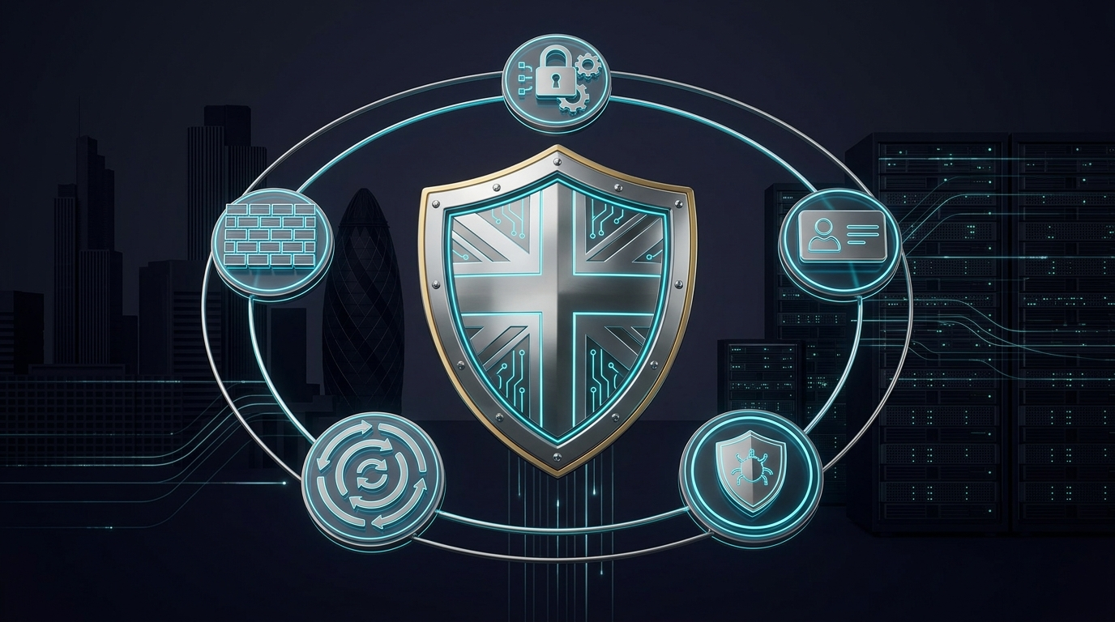
ARTICLE 3 • STATUTORY ACCREDITATION & PROCUREMENT
NCSC Cyber Essentials: The UK Government Tender Mandate
▶ THE 5 CORE SECURITY CONTROLS
Boundary Firewalls & Gateways, Secure Configuration, User Access Control, Malware Protection, and Continuous Patch Management.
▶ THE 14-DAY PATCH WINDOW
All operating systems, firewalls, and software must apply critical security updates within 14 days of vendor release—zero tolerance for legacy Windows 10/Server 2012.
▶ THE COMMERCIAL GROWTH ENGINE
Unlocks public sector bids, lowers commercial cyber insurance premiums by 20%–40%, and proves technical diligence under UK GDPR Article 32.
▶ CYBER ESSENTIALS VS CE PLUS
Cyber Essentials: Verified self-assessment with £25k indemnity. CE Plus: Hands-on independent vulnerability scan and workstation audit by IASME assessor.
OFFICIAL GOVERNMENT METRIC / STATISTIC:
Mandatory under Cabinet Office Procurement Policy Note PPN 09/14 for public sector, NHS, and defence supply chains.
Mind Reflection LTD (Company No: NI626017, Belfast) • ICO: ZA317530 • https://mindreflection.co.uk

Slide 5

ARTICLE 4 • ENCRYPTION & DATA IN TRANSIT
Cryptographic Armor: TLS 1.3, mTLS & Zero Trust PKI
▶ TLS 1.3 MANDATE
Eliminates vulnerable legacy ciphers (MD5, SHA-1, CBC); delivers 0-RTT speed and Perfect Forward Secrecy.
▶ MUTUAL TLS (MTLS)
Client and server cryptographically verify each other before data exchange (Zero Trust API standard).
▶ HSTS PRELOAD
Neutralizes SSL-stripping and downgrade attacks across public Wi-Fi networks permanently.
▶ AUTOMATED ACME LIFECYCLE
Zero-outage automated certificate renewal pipelines (Let's Encrypt / AWS ACM / Cloudflare).
OFFICIAL GOVERNMENT METRIC / STATISTIC:
Over 60% of UK mid-market firms faced unexpected downtime from expired SSL certificates in 2025/2026.
Mind Reflection LTD (Company No: NI626017, Belfast) • ICO: ZA317530 • https://mindreflection.co.uk

Slide 6
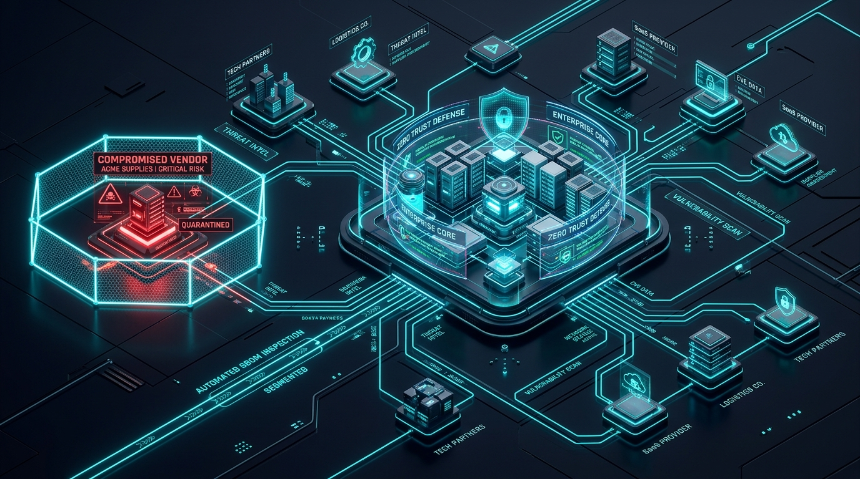
ARTICLE 5 • THIRD-PARTY GOVERNANCE & RISK
Supply Chain Cyber Defense & Vendor Risk (ISO 27001)
▶ THE TROJAN DOOR
Hackers target smaller, unpatched marketing agencies or IT contractors to pivot into enterprises.
▶ NCSC 12 PRINCIPLES
Map supplier data flows, establish contractual SLAs, verify certifications, plan rapid offboarding.
▶ ISO 27001 CONTROLS 5.19-5.23
Formal supplier relationship security policies and software dependency verification (SBOM).
▶ ZERO TRUST CONTRACTOR ACCESS
Just-In-Time (JIT) short-lived sessions without direct LAN access; immediate 60-min revocation.
OFFICIAL GOVERNMENT METRIC / STATISTIC:
Over 62% of corporate data breaches originate through compromised third-party suppliers (ENISA/NCSC).
Mind Reflection LTD (Company No: NI626017, Belfast) • ICO: ZA317530 • https://mindreflection.co.uk

Slide 7

ARTICLE 6 • CLOUD ACCESS & IDENTITY ASSURANCE
Identity as the New Perimeter: Combating MFA Fatigue
▶ MFA FATIGUE VULNERABILITY
Flooding employees with 50+ push notifications at 2:00 AM until they click 'Approve' to silence it.
▶ SESSION TOKEN THEFT
Infostealer malware lifts active browser cookies, completely bypassing passwords and 2FA codes.
▶ FIDO2 / PASSKEYS STANDARD
Hardware tokens (YubiKey) are cryptographically bound to the authentic domain—unphishable by design.
▶ CONDITIONAL ACCESS
Enforcing number matching, geolocation fencing, and managed compliant device verification.
OFFICIAL GOVERNMENT METRIC / STATISTIC:
Hackers don't break in — they log in using stolen infostealer cookies and MFA fatigue prompt bombing.
Mind Reflection LTD (Company No: NI626017, Belfast) • ICO: ZA317530 • https://mindreflection.co.uk

Slide 8
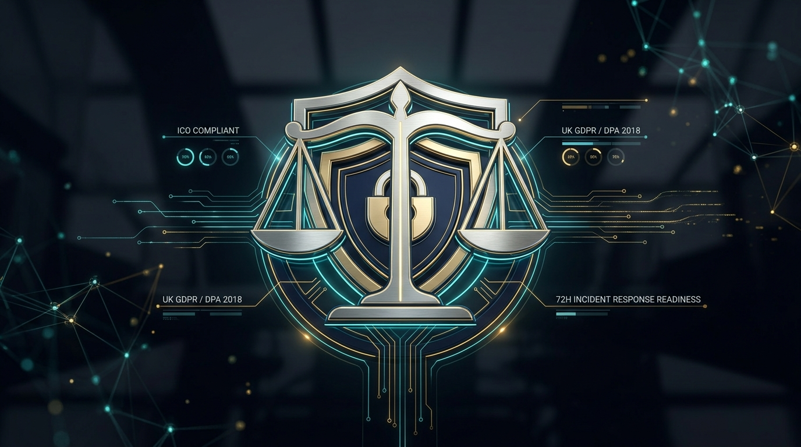
ARTICLE 7 • LEGAL & REGULATORY FIDUCIARY DUTY
The Regulatory Shield: UK GDPR, ICO Mandates & Director Duty
▶ THE 72-HOUR LEGAL CLOCK
Article 33 of UK GDPR requires formal investigation and breach disclosure to ICO within 72 hours.
▶ ARTICLE 32 SECURITY BASELINE
Statutory requirement for appropriate technical measures: MFA, encryption at rest, tested patching.
▶ DIRECTOR FIDUCIARY LIABILITY
Under the Companies Act and DSIT Governance Code, cyber neglect breaches directors' duty of care.
▶ THE CERTIFICATION DEFENSE
Maintaining Cyber Essentials and ICO Registration (ZA317530) serves as documented proof of diligence.
OFFICIAL GOVERNMENT METRIC / STATISTIC:
Fines up to £17.5M or 4% of global turnover; mandatory 72-hour breach reporting clock to the UK ICO.
Mind Reflection LTD (Company No: NI626017, Belfast) • ICO: ZA317530 • https://mindreflection.co.uk

Slide 9
THE OFFICIAL NCSC CERTIFICATION ADVANTAGE
Why Achieve UK Government Certification with Mind Reflection LTD?
100% TURNKEY GOVERNMENT ACCREDITATION
Fixed-Fee Peace of Mind for UK & NI Enterprises
🏛️ Official IASME Assessment Fee (£320) Included
No pass-through billing or unexpected surprise costs. Everything is covered in one clear invoice.
🛡️ Complimentary £25,000 Cyber Insurance (12 Mos)
Every passing business receives automatic £25k indemnity protection backed by UK insurers.
🎯 100% First-Time Pass Guarantee
If any audit finding requires remediation, we fix it and re-submit at zero additional cost to your company.
📋 Mandatory Gatekeeper for UK Tenders (PPN 09/14)
Instantly qualifies your firm to bid on UK Central Government, NHS, MoD, and enterprise supply chain contracts.
OUR TECHNICAL DIFFERENTIATORS
Why Belfast & UK Business Leaders Trust Us
★ Zero Stress, Zero 150-Question Spreadsheets
Big agencies dump a massive self-assessment form on your desk. We handle the technical heavy lifting: firewall rules, cloud MFA, patch verification, and assembling the evidence pack.
★ Audit Immunity Against 98.5% of Attacks
Official NCSC data confirms Cyber Essentials neutralizes almost all commodity ransomware, phishing, and credential stuffing attacks.
★ Substantial Commercial ROI & Insurance Discounts
Unlocks lucrative procurement bids and reduces your corporate cyber insurance premiums by up to 40%.
★ Direct Access to Senior Belfast Systems Architect
You deal directly with Lucas Malec, systems lead and founder—not outsourced call centers or junior trainees.
Mind Reflection LTD (Company No: NI626017, Belfast) • ICO: ZA317530 • https://mindreflection.co.uk

Slide 10
COMMERCIAL IMPLEMENTATION • MIND REFLECTION LTD
Turnkey Commercial Packages & 100% Pass Guarantee
PACKAGE 1
Turnkey Cyber Essentials
£650 + VAT
Official IASME Fee (£320) Included
✓ Full technical scoping & endpoint review
✓ Official IASME assessment fee covered
✓ 100% First-Time Pass Guarantee included
✓ Complimentary £25,000 Cyber Insurance (12m)
✓ Turnkey delivery in 5–7 business days
PACKAGE 2
Pro Hands-on Implementation
£1,450 + VAT
Comprehensive Multi-Site Security
✓ End-to-end device & cloud configuration
✓ Drafting compliant IT/HR security policies
✓ Multi-platform (Windows, Mac, Linux, M365)
✓ IASME submission & full remediation
✓ Pre-audit vulnerability scanning
PACKAGE 3
Continuous Cyber Care
£120 / month + VAT
Ongoing Governance Retainer
✓ Continuous 14-day critical patch monitoring
✓ Quarterly vulnerability sweeps & reviews
✓ Secure employee onboarding / offboarding
✓ Annual Cyber Essentials recertification included
✓ Direct priority access to systems lead
Mind Reflection LTD (Company No: NI626017, Belfast) • ICO: ZA317530 • https://mindreflection.co.uk

Slide 11
PARTNERSHIP & CONTACT • MIND REFLECTION LTD
Executive Next Steps: Book Your Confidential Review
READY TO SECURE YOUR CERTIFICATION & WORKFORCE DEFENSE?
Partner with Belfast's Dedicated B2B Systems & Cybersecurity Firm
Whether you need urgent Cyber Essentials accreditation to qualify for a government tender, or hands-on tactical workshops for your workforce, we deliver guaranteed results with zero disruption to your daily operations.
CONTACT DETAILS & CORPORATE INFORMATION:
• Senior Systems Architect & Lead: Lucas Malec (Founder)
• Registered Office: Belfast, Northern Ireland • Company Registration: NI626017
• Official Data Protection: ICO Registered (ZA317530)
• Direct Inquiries: info@mindreflection.co.uk
• Corporate Web Portal: https://mindreflection.co.uk
Mind Reflection LTD (Company No: NI626017, Belfast) • ICO: ZA317530 • https://mindreflection.co.uk

